Slide 1
HNN based Neuromorphic Hardware for solving Combinatorial Optimization Problems
Simulations
Asish Kumar Mandoi
04.06.2023

Slide 2

Hopfield Neural Networks: Overview
A recurrent neural network that implements the following neuron update
$X$

Slide 3
Maximum Weighted Cut Problem

Slide 4
Formulation
Max – Cut

Slide 5
Motivation and Prior Works
Why do we need a hardware to calculate dot-products?
Dot products are one of the most common mathematical operations in machine learning, statistics, signal/image processing, etc, but will more importantly be highly essential in neuromorphic applications.
Dot-product circuits speed up the calculation of vector-matrix multiplication, compared to a CPU.
Why is stochastic implementation necessary?
“Computations by brain are inherently stochastic.” Very low SNR of neuronal signals plays an important role in the brain’s functionality.
There are several other emerging hardware that are built with a focus on solving optimization problems. For e.g.:
nanomagnets
CMOS
Josephson Junction (Quantum Annealing)
Photonics
https://web.ece.ucsb.edu/~strukov/papers/2021/semicon2021.pdf

Slide 6
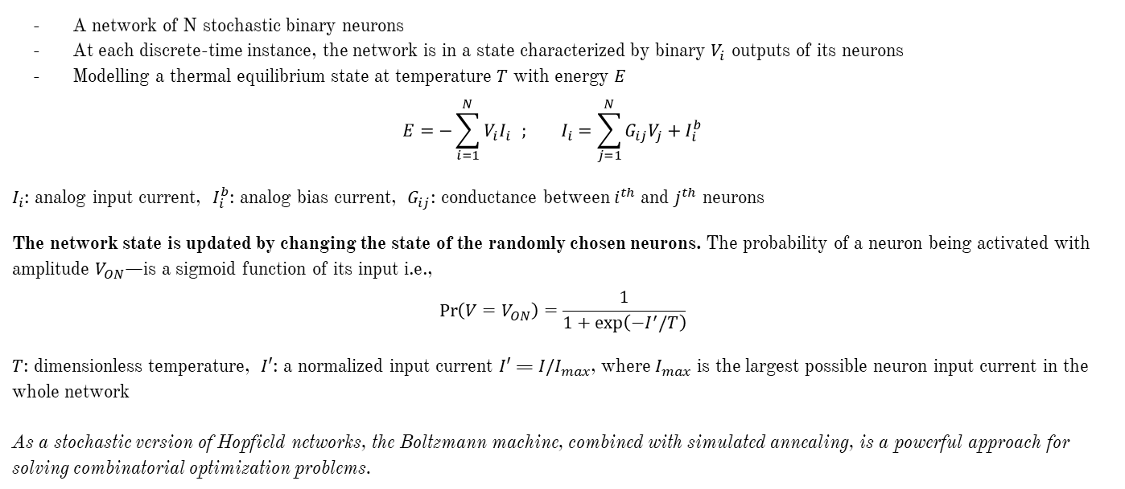
The idea behind a Boltzmann Machine
A network of N stochastic binary neurons
At each discrete-time instance, the network is in a state characterized by binary $V_{i}$ outputs of its neurons
Modelling a thermal equilibrium state at temperature $T$ with energy $E$
$$E=−\sum_{i=1}^{N}{V_{i}I_{i}} ; I_{i}=\sum_{j=1}^{N}{G_{ij}V_{j}+I_{i}^{b}}$$
$I_{i}$: analog input current, $I_{i}^{b}$: analog bias current, $G_{ij}$: conductance between $i^{th}$ and $j^{th}$ neurons
The network state is updated by changing the state of the randomly chosen neurons. The probability of a neuron being activated with amplitude $V_{ON}$—is a sigmoid function of its input i.e., $$\operatorname{Pr}\left(V=V_{ON}\right)=\frac{1}{1+\exp\left(−I^{′}/T\right)}$$
$T$: dimensionless temperature, $I′$: a normalized input current $I′$ = ${I/I}_{max}$, where $I_{max}$ is the largest possible neuron input current in the whole network As a stochastic version of Hopfield networks, the Boltzmann machine, combined with simulated annealing, is a powerful approach for solving combinatorial optimization problems.

Slide 7
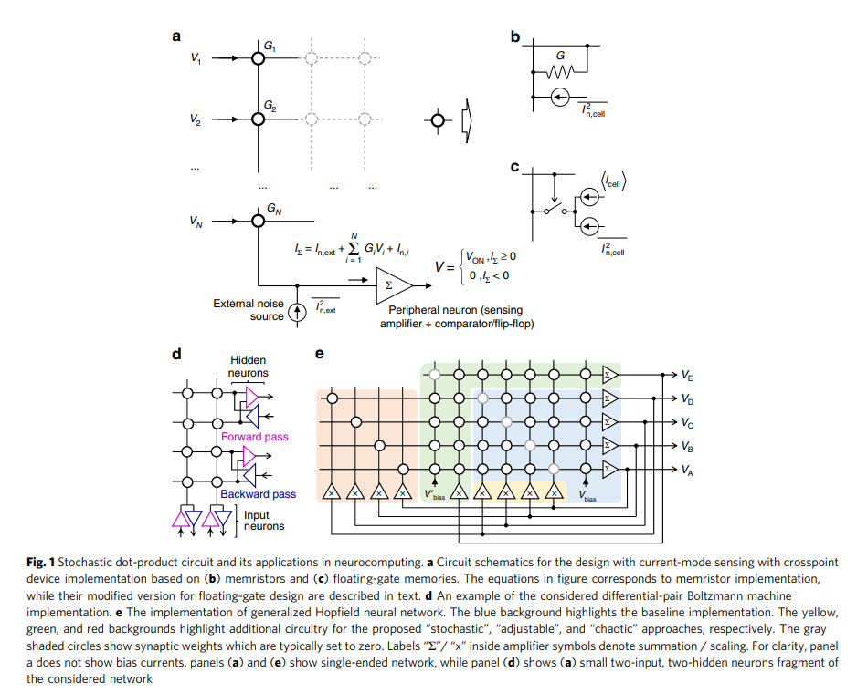

Slide 8
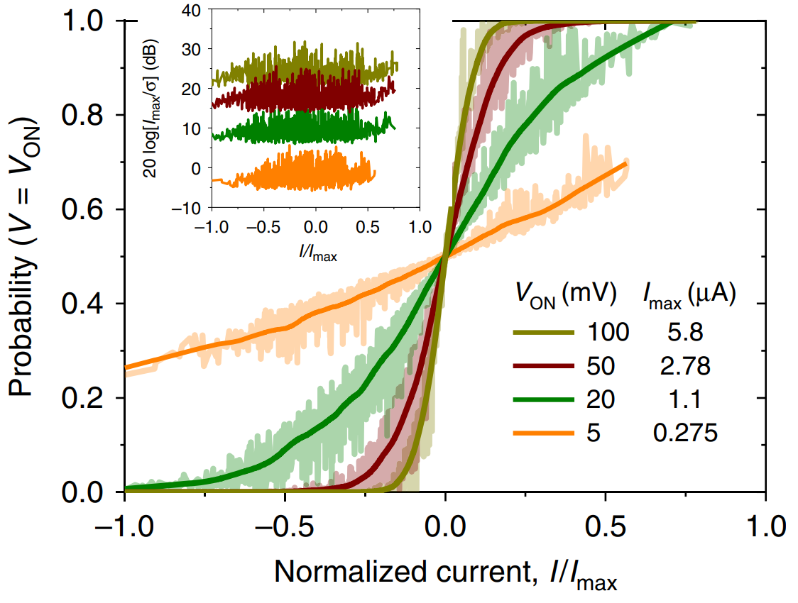
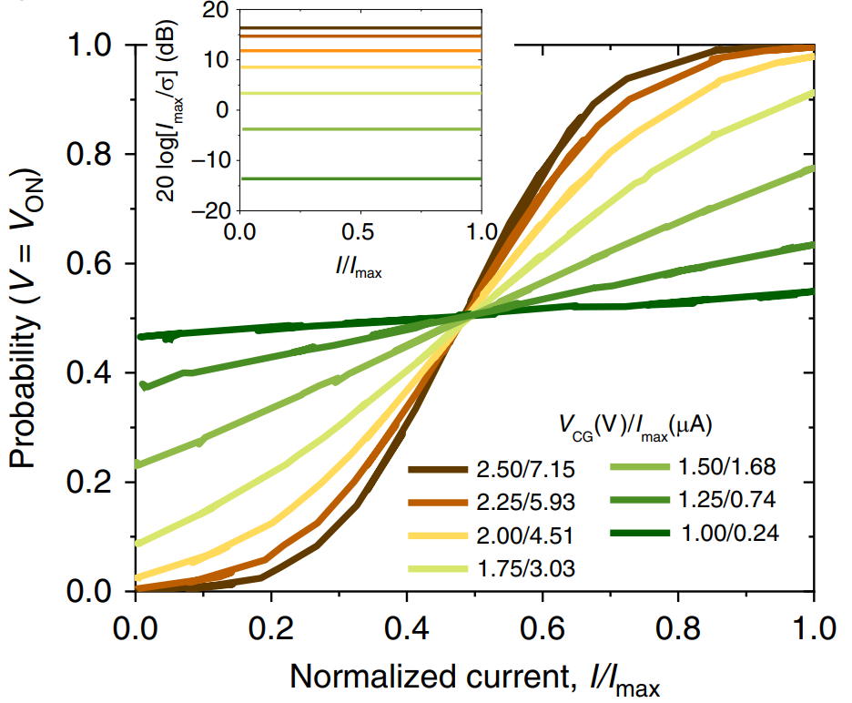
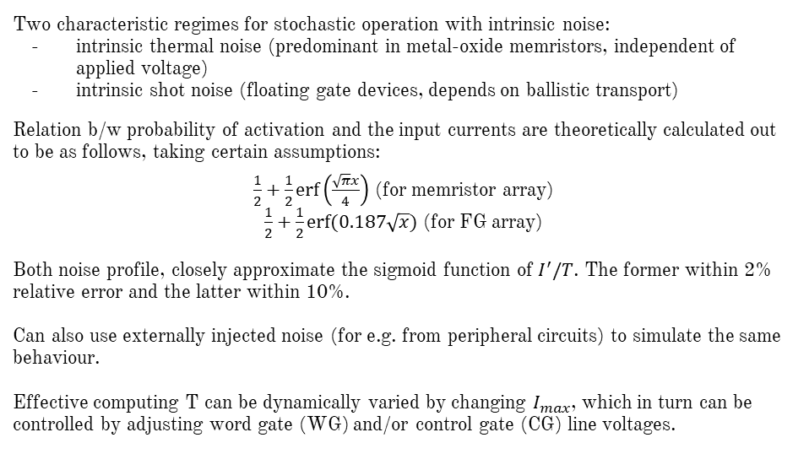
Noise Characterization and Working of Crossbar Memory Arrays
Two characteristic regimes for stochastic operation with intrinsic noise:
intrinsic thermal noise (predominant in metal-oxide memristors, independent of applied voltage)
intrinsic shot noise (floating gate devices, depends on ballistic transport)
Relation b/w probability of activation and the input currents are theoretically calculated out to be as follows, taking certain assumptions:
$\frac{1}{2}+\frac{1}{2}\operatorname{erf}\left(\frac{\sqrt{π}x}{4}\right)$ (for memristor array) $\frac{1}{2}+\frac{1}{2}erf⁡(0.187\sqrt{x})$ (for FG array)
Both noise profile, closely approximate the sigmoid function of $I^{′}/T$. The former within 2% relative error and the latter within 10%. Can also use externally injected noise (for e.g. from peripheral circuits) to simulate the same behaviour. Effective computing T can be dynamically varied by changing $I_{max}$, which in turn can be controlled by adjusting word gate (WG) and/or control gate (CG) line voltages.
Approximate sigmoidal behavior in a (Top: memristor-based, Bottom: floating-gate memory-based) stochastic neuron with external noise. The inset shows peak signal-to-noise ratios across full range of neuron’s input currents.

Slide 9
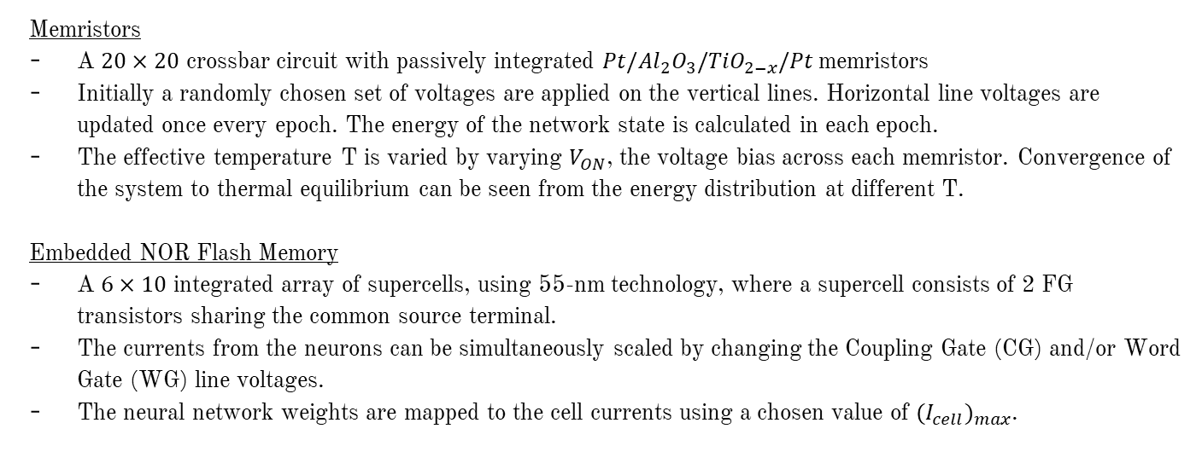
Operating the Boltzmann Machine
Memristors
A $20×20$ crossbar circuit with passively integrated $Pt/Al_{2}O_{3}/TiO_{2−x}/Pt$ memristors
Initially a randomly chosen set of voltages are applied on the vertical lines. Horizontal line voltages are updated once every epoch. The energy of the network state is calculated in each epoch.
The effective temperature T is varied by varying $V_{ON}$, the voltage bias across each memristor. Convergence of the system to thermal equilibrium can be seen from the energy distribution at different T.
Embedded NOR Flash Memory
A $6×10$ integrated array of supercells, using 55-nm technology, where a supercell consists of 2 FG transistors sharing the common source terminal.
The currents from the neurons can be simultaneously scaled by changing the Coupling Gate (CG) and/or Word Gate (WG) line voltages.
The neural network weights are mapped to the cell currents using a chosen value of ${(I_{cell})}_{max}$.

Slide 10
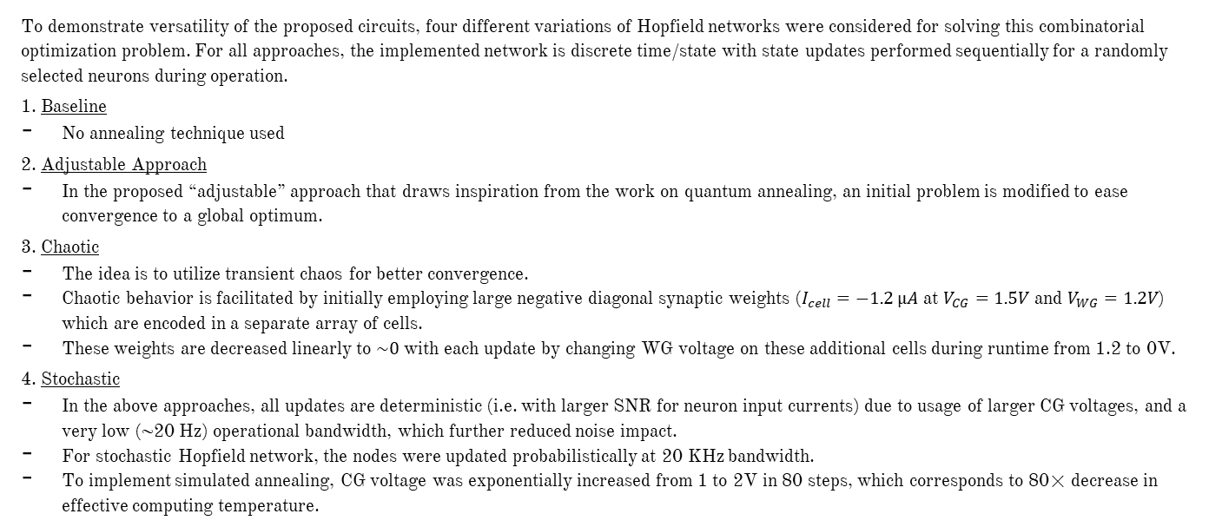
Demonstrating Versatility
To demonstrate versatility of the proposed circuits, four different variations of Hopfield networks were considered for solving this combinatorial optimization problem. For all approaches, the implemented network is discrete time/state with state updates performed sequentially for a randomly selected neurons during operation.
1. Baseline
No annealing technique used
2. Adjustable Approach
In the proposed “adjustable” approach that draws inspiration from the work on quantum annealing, an initial problem is modified to ease convergence to a global optimum.
3. Chaotic
The idea is to utilize transient chaos for better convergence.
Chaotic behavior is facilitated by initially employing large negative diagonal synaptic weights ($I_{cell}=−1.2 µA$ at $V_{CG}=1.5V$ and $V_{WG}=1.2V$) which are encoded in a separate array of cells.
These weights are decreased linearly to $\sim 0$ with each update by changing WG voltage on these additional cells during runtime from 1.2 to 0V.
4. Stochastic
In the above approaches, all updates are deterministic (i.e. with larger SNR for neuron input currents) due to usage of larger CG voltages, and a very low (~20 Hz) operational bandwidth, which further reduced noise impact.
For stochastic Hopfield network, the nodes were updated probabilistically at 20 KHz bandwidth.
To implement simulated annealing, CG voltage was exponentially increased from 1 to 2V in 80 steps, which corresponds to 80× decrease in effective computing temperature.

Slide 11
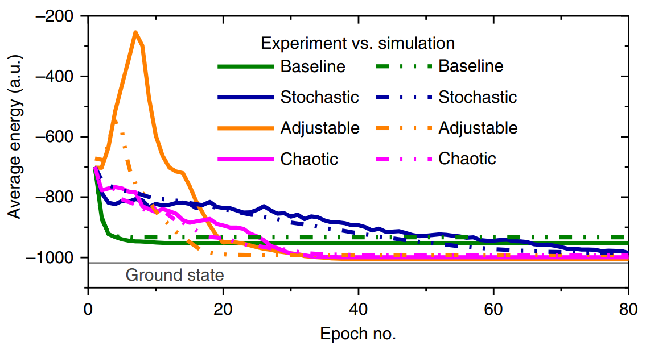
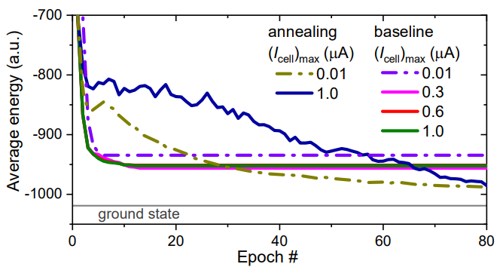
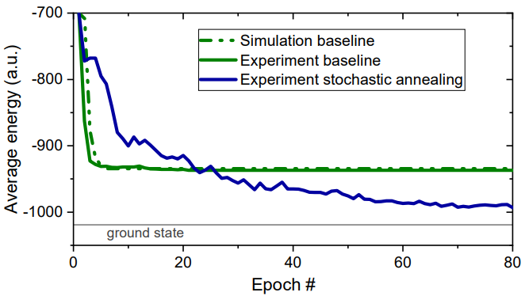
Results and Comparison
The convergence for the baseline approach is fast, but the network often gets stuck in the local minima. Thus, the final energy, averaged over many runs, is substantially higher than the global optimum (“ground state” line in fig. 1a)
On the other hand, optimal solution was almost always found using three remaining approaches.
For the adjustable approach, the initial increase in energy of the original 4-node problem is expected, given the quick convergence to the global energy optimum of the 5-node problem. As the additional node is gradually eliminated from the network, 4-node problem energy quickly drops to below baseline level, resulting in a better solution.
Fig. 1b: Experimental (solid lines) and SPICE simulation (dot-dash) results for flash memory circuits assuming intrinsic noise of field effect transistor for the stochastic approach, and noise-free operation for the baseline approach.
Fig. 1c: Experimental (solid lines) and simulation (dot-dashed) results for memristor-based circuits. The shown experimental data are averaged over 160 runs (10 runs for each of the 16 initial states).
Fig. 1a: Simulation and experimental results for solving the graph partitioning problem with floating-gate memory

Slide 12
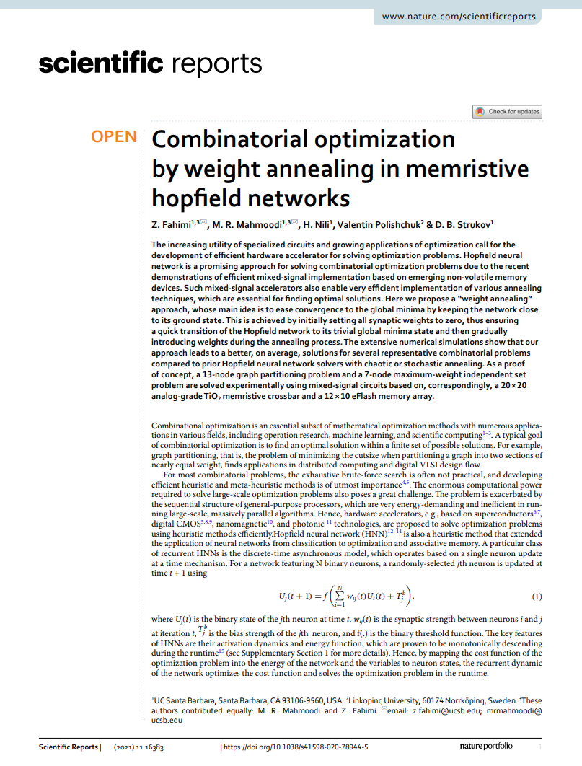
Combinatorial Optimization by weight annealing in memristive Hopfield networks
Z. Fahimi, M.R. Mahmoodi, H. Nili, Valentin Polishchuk & D.B. Strukov

Slide 13
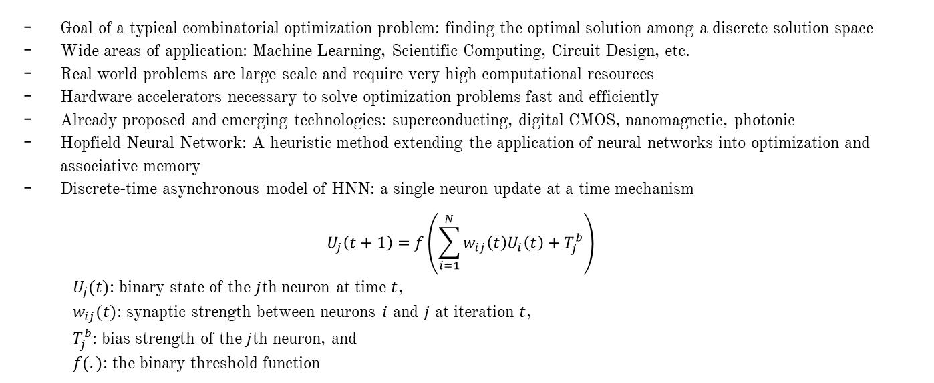
Hardware Accelerators for Combinatorial Optimization
Goal of a typical combinatorial optimization problem: finding the optimal solution among a discrete solution space
Wide areas of application: Machine Learning, Scientific Computing, Circuit Design, etc.
Real world problems are large-scale and require very high computational resources
Hardware accelerators necessary to solve optimization problems fast and efficiently
Already proposed and emerging technologies: superconducting, digital CMOS, nanomagnetic, photonic
Hopfield Neural Network: A heuristic method extending the application of neural networks into optimization and associative memory
Discrete-time asynchronous model of HNN: a single neuron update at a time mechanism
$$U_{j}\left(t+1\right)=f\left(\sum_{i=1}^{N}{w_{ij}\left(t\right)U_{i}\left(t\right)+T_{j}^{b}}\right)$$
$U_{j}(t)$: binary state of the $j$th neuron at time $t$,
$w_{ij}(t)$: synaptic strength between neurons $i$ and $j$ at iteration $t$,
$T_{j}^{b}$: bias strength of the $j$th neuron, and
$f(.)$: the binary threshold function

Slide 14

Motivation and Prior Works
Goal for an ideal efficient HNN accelerator: Perform the frequent dot-product operation very fast and support an annealing technique to avoid getting trapped in local minima. Simulated and chaotic annealing tackle this problem by applying thermally controlled probabilistic jumps.
Adaptivity
Change the energy landscape such that the weight changes are adapted to the current state, i.e., reuse insights gained from previous iterations.
Mimicking this adaptivity within any hardware could be inefficient as performing individual changes to the weights would consume significant time and energy.
Weight annealing overcomes this limitation as follows:
All weights are scaled together at every iteration
Although the hardware takes care of the derivatives, convergence, escaping local optima with stochastic decisions, etc., the annealing schedule is pre-set and does not depend on the state of the system
Prior works
A small-scale 4-bit data converter with Hopfield model using discrete $Pt/TiO_{2−x}/Pt$ memristive devices
A 3-bit associative memory based on digital $HfO_{2}$ memristors
simulated annealing within Hopfield networks using the inherent chaos in sub-100 nm $NbO_{2}$ memristors
An 18-node restricted Boltzmann machine based on a versatile stochastic dot-product engine using $TiO_{2}$ memristive crossbars
Inherently random switching mechanism of memories to implement stochastic sigmoid neuron functionality and simulated annealing. But such implementations suffer from the limited switching endurance, cycle-to-cycle and device-to-device variations, and scalability issues
A 3-bit associative memory based on the Hopfield model using Y-flash memories
Hardware implementation of simulated, chaotic, and adjustable annealing within HNNs [The prev. paper in this presentation]

Slide 15
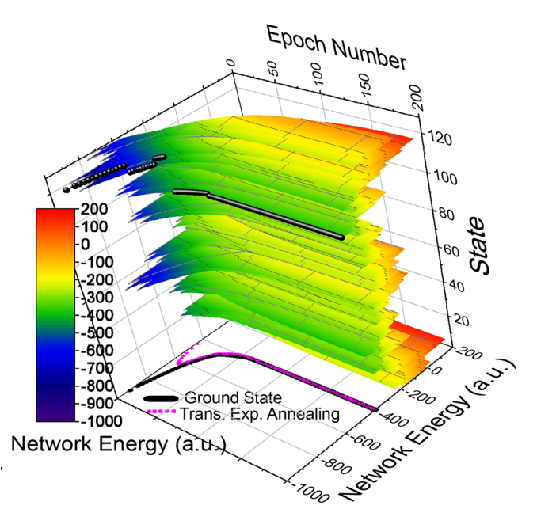
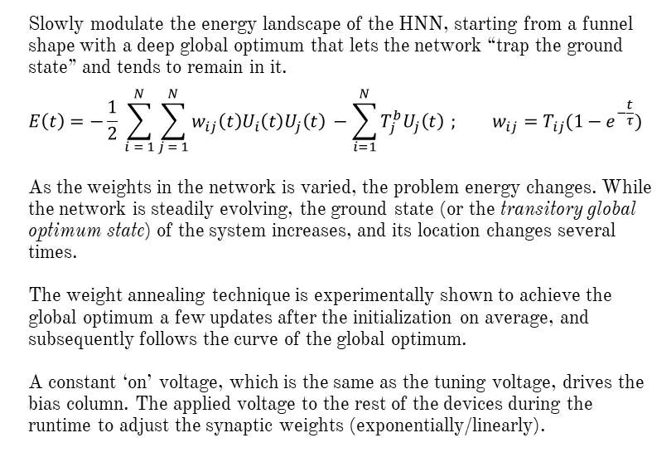
Weight Annealing
Slowly modulate the energy landscape of the HNN, starting from a funnel shape with a deep global optimum that lets the network “trap the ground state” and tends to remain in it.
$$E\left(t\right)=−\frac{1}{2} \sum_{i = 1}^{N}{\sum_{j = 1}^{N}{w_{ij}\left(t\right)U_{i}\left(t\right)U_{j}\left(t\right)}} −\sum_{i=1}^{N}{T_{j}^{b}U_{j}\left(t\right)} ; w_{ij}=T_{ij}(1−e^{−\frac{t}{τ}})$$
As the weights in the network is varied, the problem energy changes. While the network is steadily evolving, the ground state (or the transitory global optimum state) of the system increases, and its location changes several times.
The weight annealing technique is experimentally shown to achieve the global optimum a few updates after the initialization on average, and subsequently follows the curve of the global optimum.
A constant ‘on’ voltage, which is the same as the tuning voltage, drives the bias column. The applied voltage to the rest of the devices during the runtime to adjust the synaptic weights (exponentially/linearly).
The energy evolution of each state during weight annealing for 200 epochs and τ = 40. The black curve marks the transitory ground state of the system. The magenta curve shows the average transitory energy over 128 runs.

Slide 16
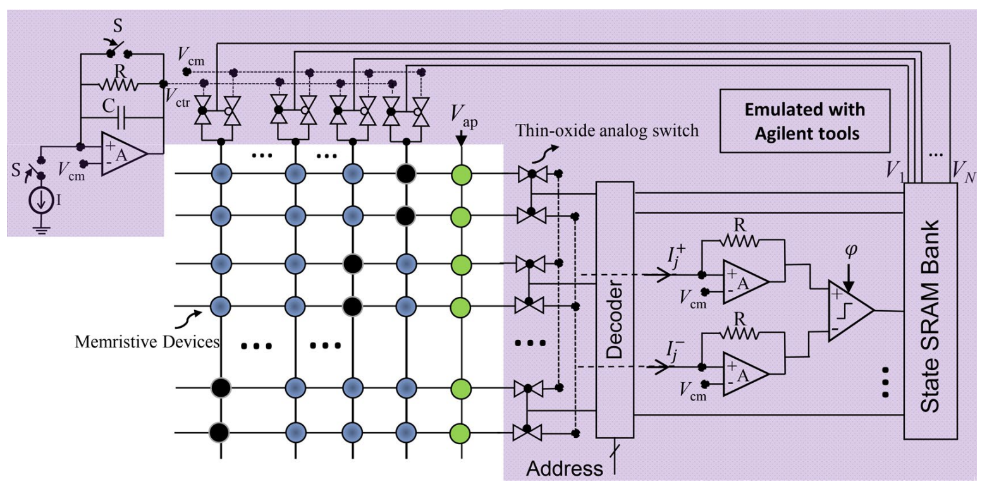
Implementation of Weight Annealing
Values R, C, and I depend on the problem size and technology, and determine the annealing schedule. Switch S resets the network to the initial condition. The selected neuron is determined by the input address to the decoder, and the operation is synchronized with the sampling clock (ϕ) in dynamic comparator

Slide 17
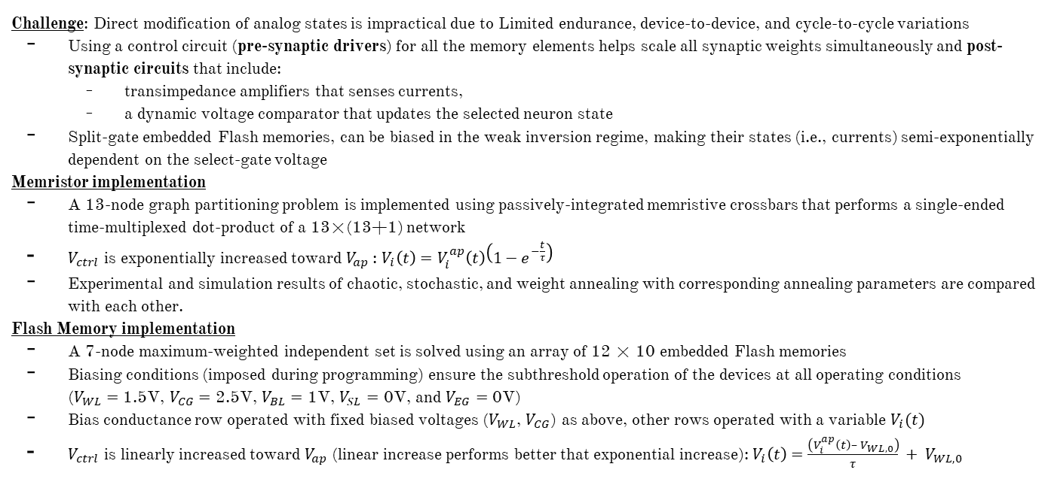
Operation
Challenge: Direct modification of analog states is impractical due to Limited endurance, device-to-device, and cycle-to-cycle variations
Using a control circuit (pre-synaptic drivers) for all the memory elements helps scale all synaptic weights simultaneously and post-synaptic circuits that include:
transimpedance amplifiers that senses currents,
a dynamic voltage comparator that updates the selected neuron state
Split-gate embedded Flash memories, can be biased in the weak inversion regime, making their states (i.e., currents) semi-exponentially dependent on the select-gate voltage
Memristor implementation
A 13-node graph partitioning problem is implemented using passively-integrated memristive crossbars that performs a single-ended time-multiplexed dot-product of a 13×(13+1) network
$V_{ctrl}$ is exponentially increased toward $V_{ap}$: $V_{i}\left(t\right)=V_{i}^{ap}\left(t\right)\left(1−e^{−\frac{t}{τ}}\right)$
Experimental and simulation results of chaotic, stochastic, and weight annealing with corresponding annealing parameters are compared with each other.
Flash Memory implementation
A 7-node maximum-weighted independent set is solved using an array of 12 × 10 embedded Flash memories
Biasing conditions (imposed during programming) ensure the subthreshold operation of the devices at all operating conditions ($V_{WL}=$ 1.5V, $V_{CG}=$ 2.5V, $V_{BL}=$ 1V, $V_{SL}=$ 0V, and $V_{EG}=$ 0V)
Bias conductance row operated with fixed biased voltages ($V_{WL}$, $V_{CG}$) as above, other rows operated with a variable $V_{i}(t)$
$V_{ctrl}$ is linearly increased toward $V_{ap}$ (linear increase performs better that exponential increase): $V_{i}\left(t\right)=\frac{\left(V_{i}^{ap}\left(t\right)– V_{WL,0}\right)}{τ} + V_{WL,0}$

Slide 18
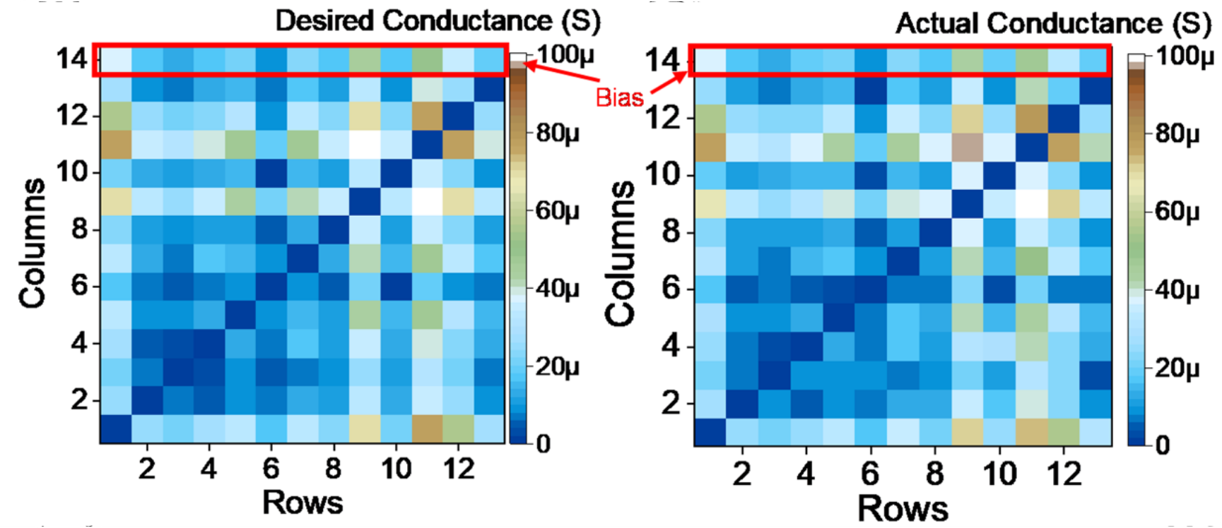
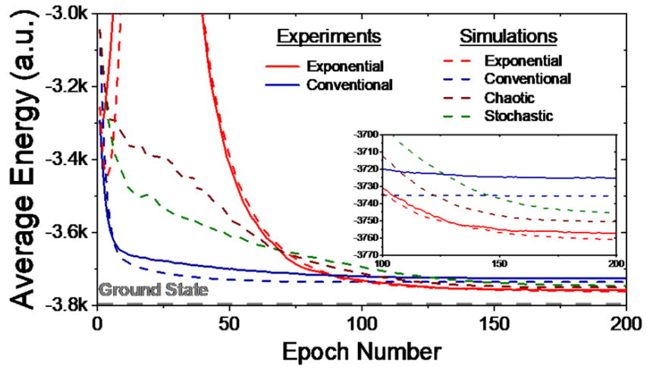
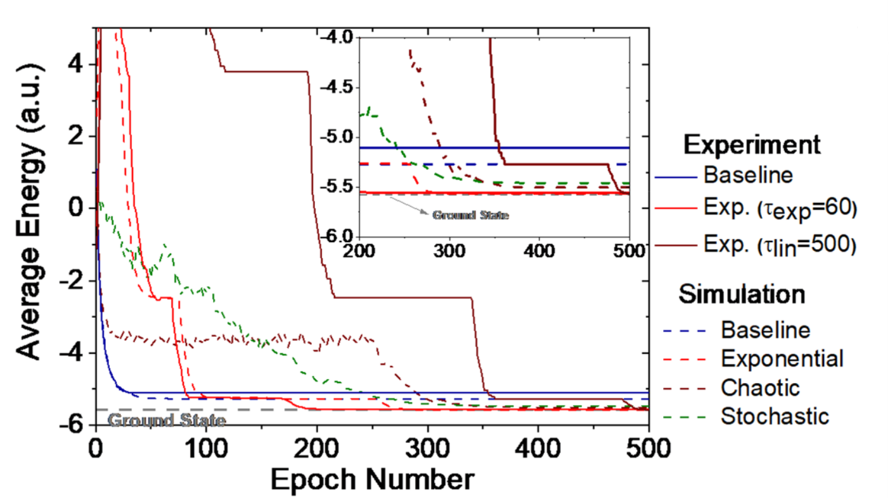
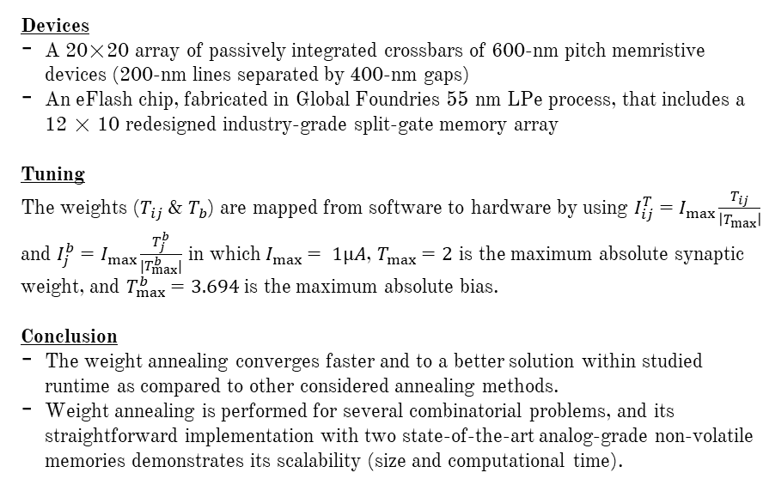
Results
Devices
A 20×20 array of passively integrated crossbars of 600-nm pitch memristive devices (200-nm lines separated by 400-nm gaps)
An eFlash chip, fabricated in Global Foundries 55 nm LPe process, that includes a 12 × 10 redesigned industry-grade split-gate memory array
Tuning
The weights ($T_{ij}$ & $T_{b}$) are mapped from software to hardware by using $I_{ij}^{T}=I_{max}\frac{T_{ij}}{\left|T_{max}\right|}$ and $I_{j}^{b}=I_{max}\frac{T_{j}^{b}}{|T_{max}^{b}|}$ in which $I_{max}⁡= 1µA$, $T_{max}=2$ is the maximum absolute synaptic weight, and $T_{max}^{b}=3.694$ is the maximum absolute bias.
Conclusion
The weight annealing converges faster and to a better solution within studied runtime as compared to other considered annealing methods.
Weight annealing is performed for several combinatorial problems, and its straightforward implementation with two state-of-the-art analog-grade non-volatile memories demonstrates its scalability (size and computational time).
Conductance map obtained before and after tuning the crossbar
The average energy versus epoch comparing experimental results with simulations for (i) [top] memristor crossbar with over 1000 runs, (ii) [bottom] eFlash memory with over 100 runs

Slide 19
Introduction
Annealing techniques are a useful class of metaheuristic that provide a way of escaping from local minima thus aiding in the best optimization performance.
Emerging technologies for Ising solvers: CMOS, Superconductors, nanomagnets, photonic technology
Generalized Hopfield Neural Network: An approach closely related to Ising Model
Similar to Ising solvers, annealing techniques are also applicable in HNNs, e.g. by probabilistically updating neuron states can give a huge performance improvement.
This work focusses on the development of adjustable resistive switching devices (such as metal-oxide memristor) that meet the following goals.
1. computing dot-product operations with dense adjustable weights
2. implementing stochastic neurons to support metaheuristic techniques
An “exponential” annealing (EA) technique, which is especially suitable for the proposed hardware is also proposed.

Slide 20
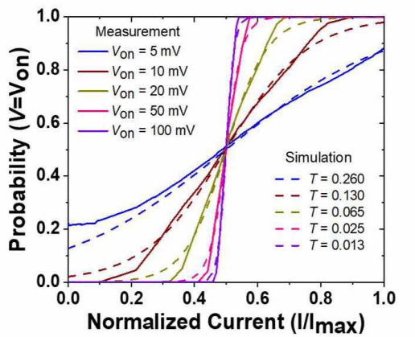
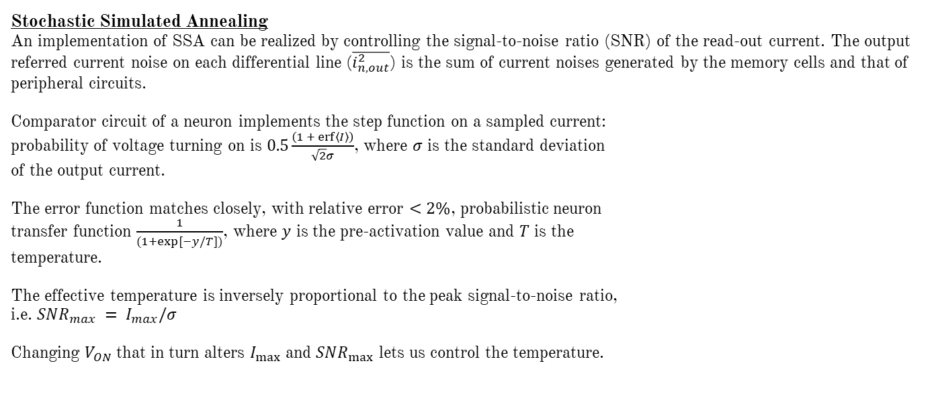
Implementing Annealing Methods
Stochastic Simulated Annealing
An implementation of SSA can be realized by controlling the signal-to-noise ratio (SNR) of the read-out current. The output referred current noise on each differential line ($\overline{i_{n,out}^{2}}$) is the sum of current noises generated by the memory cells and that of peripheral circuits.
Comparator circuit of a neuron implements the step function on a sampled current: probability of voltage turning on is $0.5\frac{\left(1 + erf\left\langle I\right\rangle \right)}{\sqrt{2}σ}$, where $σ$ is the standard deviation of the output current.
The error function matches closely, with relative error $<2\%$, probabilistic neuron transfer function $\frac{1}{(1+exp⁡[−y/T])}$, where $y$ is the pre-activation value and $T$ is the temperature.
The effective temperature is inversely proportional to the peak signal-to-noise ratio, i.e. $SNR_{max} = I_{max}/σ$
Changing $V_{ON}$ that in turn alters $I_{max}$ and $SNR_{max}$ lets us control the temperature.
Measured probabilistic sigmoid using the intrinsic noise of the circuit vs simulation of ideal sigmoid

Slide 21
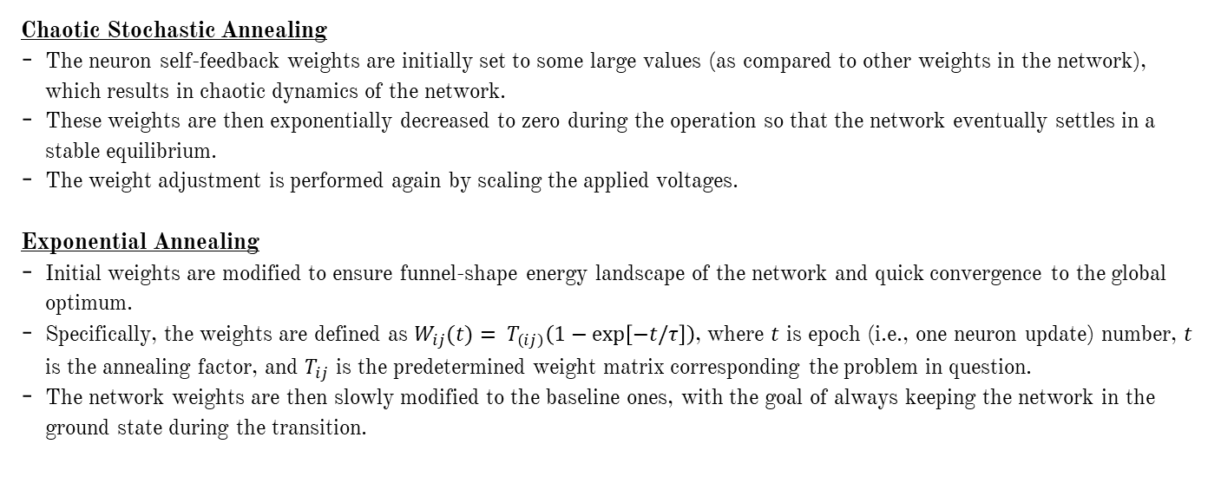
Implementing Annealing Methods
Chaotic Stochastic Annealing
The neuron self-feedback weights are initially set to some large values (as compared to other weights in the network), which results in chaotic dynamics of the network.
These weights are then exponentially decreased to zero during the operation so that the network eventually settles in a stable equilibrium.
The weight adjustment is performed again by scaling the applied voltages.
Exponential Annealing
Initial weights are modified to ensure funnel-shape energy landscape of the network and quick convergence to the global optimum.
Specifically, the weights are defined as $W_{ij}(t)= T_{\left(ij\right)}\left(1−\exp\left[−t/τ\right]\right)$, where $t$ is epoch (i.e., one neuron update) number, $t$ is the annealing factor, and $T_{ij}$ is the predetermined weight matrix corresponding the problem in question.
The network weights are then slowly modified to the baseline ones, with the goal of always keeping the network in the ground state during the transition.

Slide 22
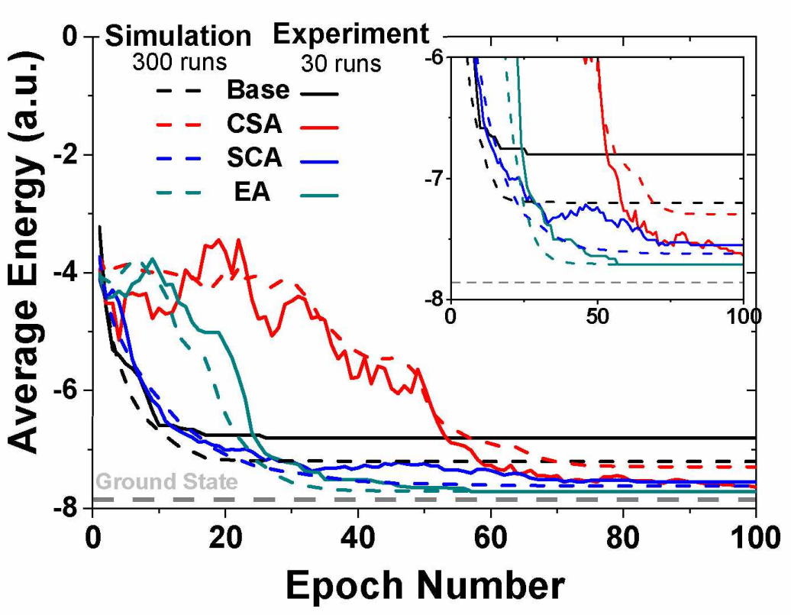
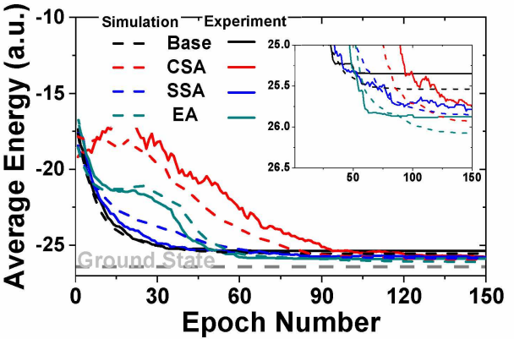
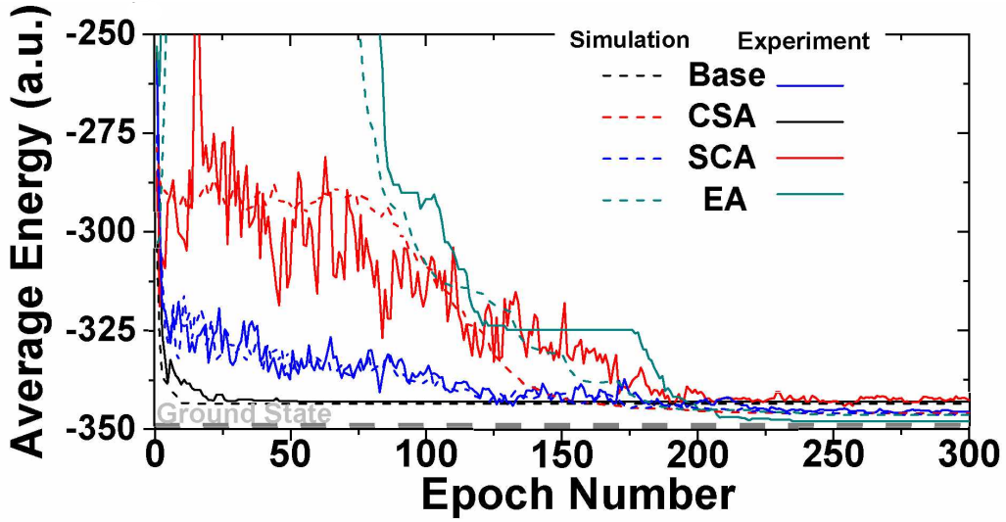
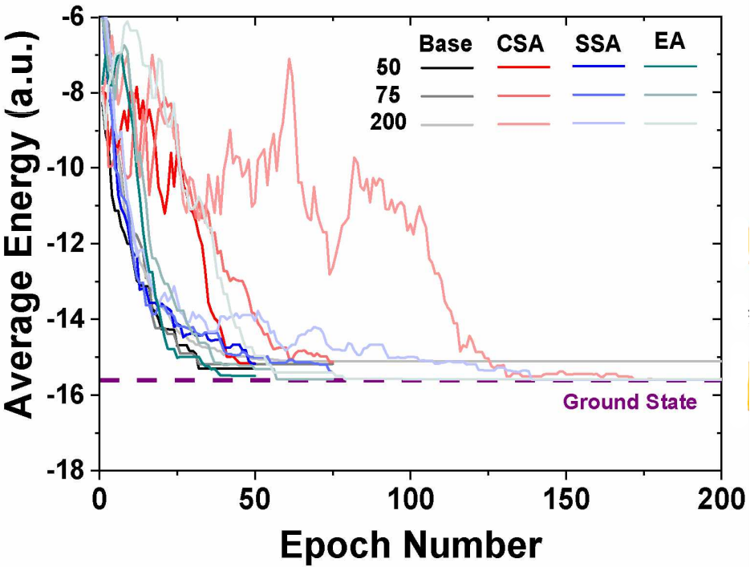
Results
Four common combinatorial optimization problems were solved with all the previously discussed methods:
weighted maximum-clique problems
weighted vertex cover problem
independent set problem
graph partitioning problem
The experimental results showed improved performance for all annealing techniques over the baseline approach, and superior performance of exponential annealing compared to stochastic and chaotic annealing.
Fig (a): 5-node maximum weighted clique problem: The average energy vs epochs
Fig (b): 12-node minimum weighted vertex cover problem: The average energy (300 runs for simulation and 30 runs for experiment) vs epochs
Fig (c): 10-node maximum weight independent set problem: The experimental average energy (over 30 runs) vs epochs with three different annealing schedules
Fig (d): 10-node graph partitioning problem: The average energy (300 runs for simulation and 30 runs for experiment) vs epochs

Slide 23
“(It has been shown that) highly interconnected networks of simple analog processors can collectively compute good solutions to difficult optimization problems. ... In difficult problems of recognition and perception, where rapidly calculated good solutions may be more beneficial than slowly computed globally optimal solutions, collective computation in circuits of this design may be of practical use.”
David W. Tank & John J. Hopfield, “Simple ‘Neural’ Optimization Networks: An A/D Converter, Signal Decision Circuit, and a Linear Programming Circuit”, 5 May 1986

Slide 24
Thank You!

